Slide 1
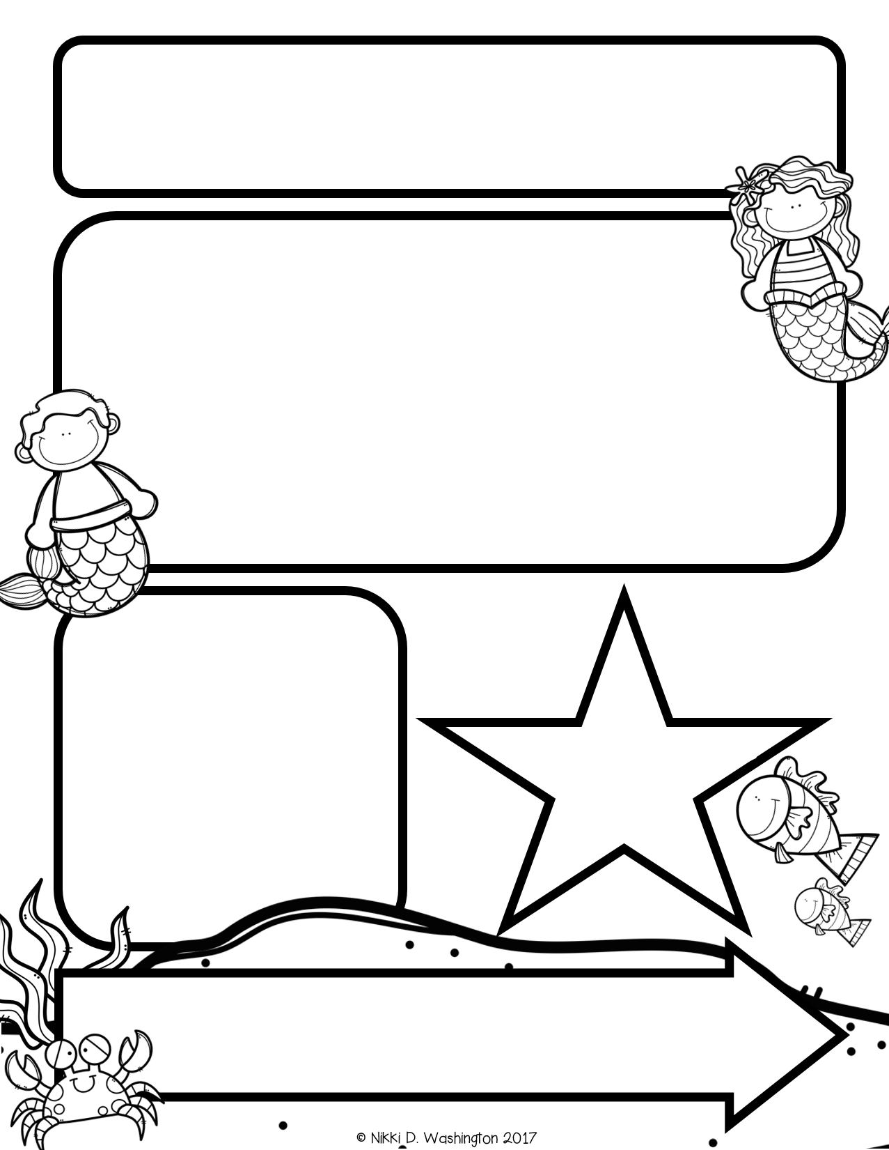
Mrs. Zeock’s Class
Newsletter
9/14/2018
Everyone survived (myself included ☺) the first full week of school! I have a feeling there will be many tired children this weekend.
Next Wednesday, we are having Clifford Day! Please dress your child in red on Wednesday. We will be reading Clifford books and doing some fun activities that go with the Clifford theme.
Thank you for staying in the Hugs and Kisses zone when dropping your kids off in the morning. Being a mom that had a child with separation anxiety, I know it might not be easy, but there are a few reasons for this zone. One, we want your kids to become independent and this is a great way for that to happen. Second, we are really working hard on keeping our school safe. When there are so many adults in the hallway, it is difficult to know who or if they actually are supposed to be here. If you need to talk to me, feel free to email me or call the office to set up a time to meet with me ☺.
Lastly, on the back of the newsletter I will let you know what we worked on every week. This way you will know what your child is working on and what they should know.
Up Coming Events
September 19-Clifford Day
October 4-Field Trip
October 25-Fall Fest
October 31-Halloween Party
Supplies needed:
Hand Sanitizer
Volunteers needed: In the upcoming months, I will need
volunteers to help listen to students read. I will send out more information at a later date.

Slide 2
Math
This week we started Unit 1. The students are learning the numbers 1, 2, 3, 4, and 5. They have learned how to count objects and write the numbers.
*Starting next week, I will be sending home a homework sheet from the lesson we covered that day. Please complete this with your child for extra practice; however, you do not have to return it.
Reading and Writing
This week we learned that we are all readers! We walked around the school and classroom reading real world signs. The students also learned about real world books and how we can learn from them by just looking at the pictures. During our phonics time, we learned about the letter “M.” We learned the name, sound, and how to write the letter.
Science
This week we started our unit on the Five Senses. We learned the five senses by smelling, touching, hearing, looking, and tasting popcorn.

