Slide 1
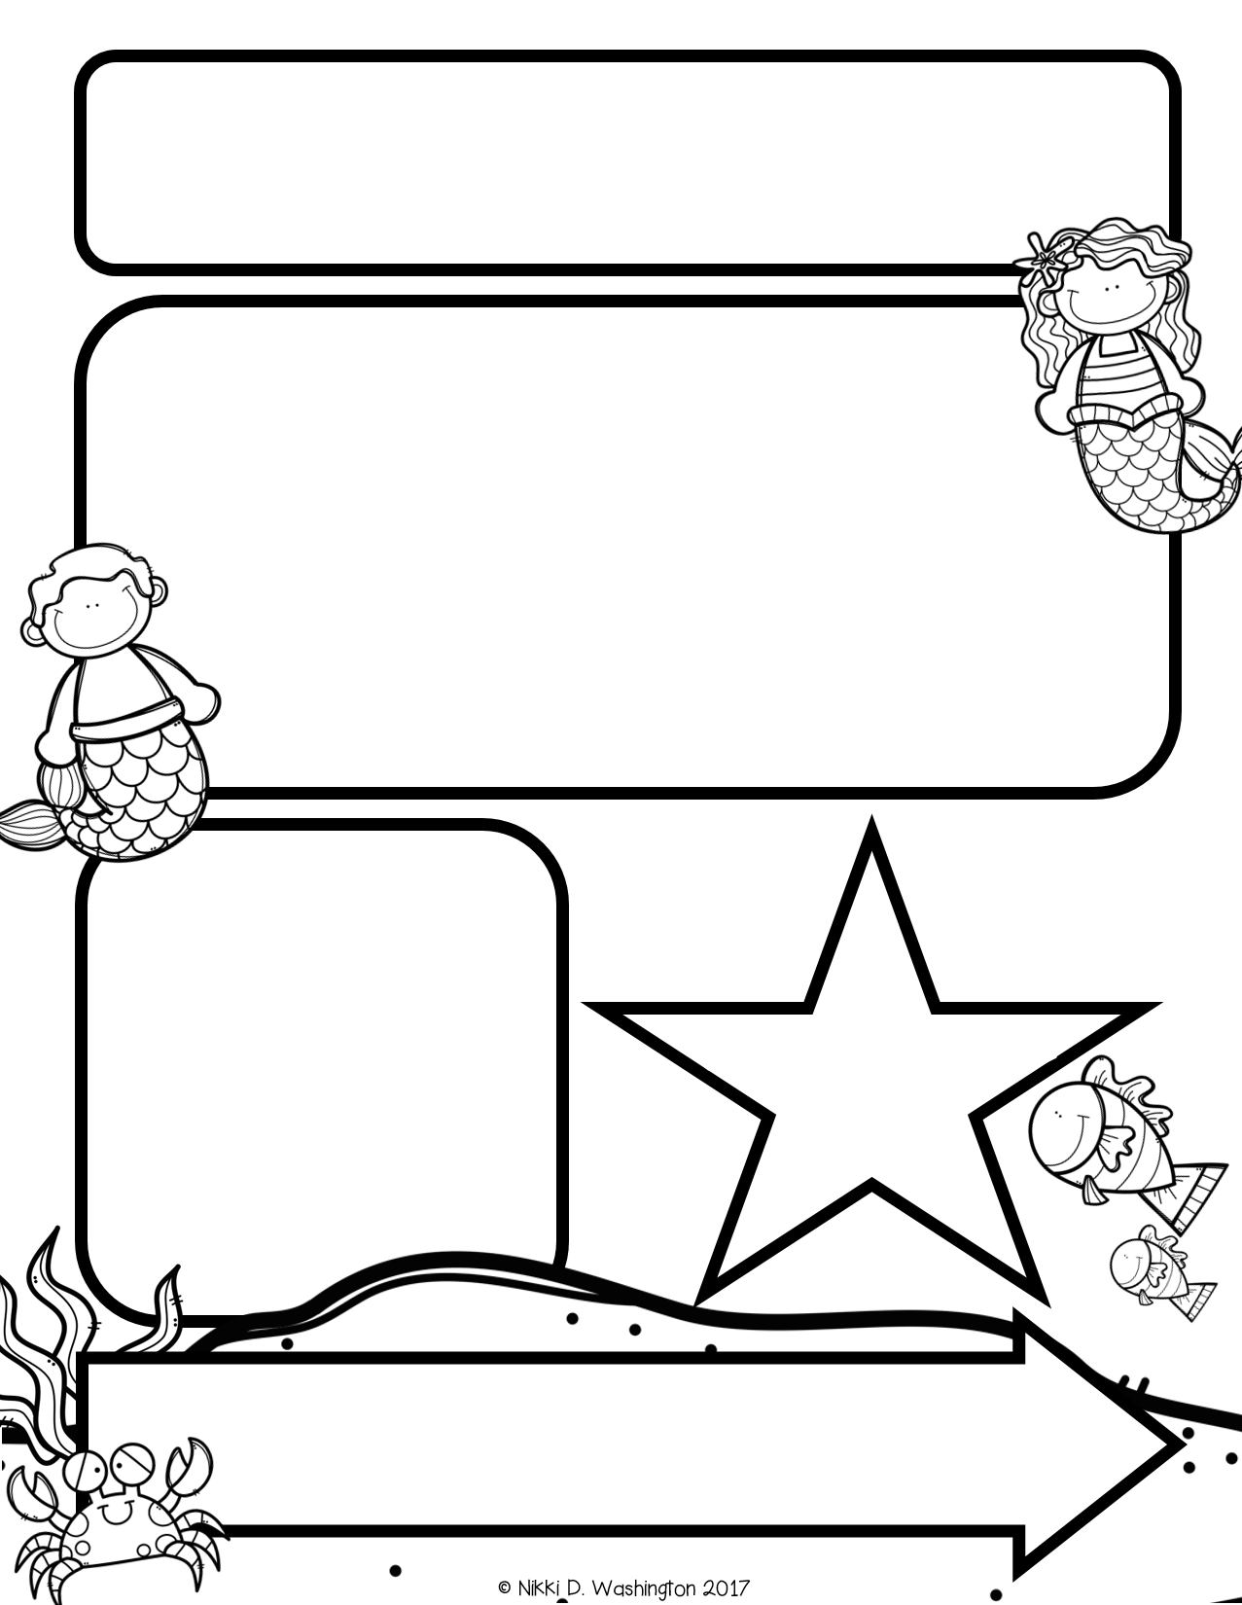
Mrs. Zeock’s Class
Newsletter
9/28/2018
The Kindergarteners are excited about the field trip next Thursday! This morning they were able to take a short bus ride and learn all about bus safety, so they know how to behave next week on our long ride. If you are planning to come on our trip, you are more than welcome to ride the bus with us. It will be crowded, but we should all fit. Please let me know if you plan to drive instead of riding the bus. This weekend, I will be checking the approved volunteer list. If your name is not on the list, you are not allowed to go. This is for our children’s safety.
Up Coming Events
September 28-Purple Game at OHS
October 4-Field Trip
October 8-Picture Day
October 25-Fall Fest
October 31-Halloween Party
Supplies needed:
Volunteers needed: In the upcoming months, I will need
volunteers to help listen to students read. I will send out more information at a later date.

Slide 2
Math
We continued unit 1 in math. The students are learning the numbers 1, 2, 3, 4, and 5. They have learned how to count objects and write the numbers. Next week the students will be taking their first math assessment on unit 1.
*I started sending home a homework sheet from the lesson we covered during the day. Please complete this with your child for extra practice; however, you do not have to return it.
Reading and Writing
This week we learned the letters A and L. We learned the name, sound, and how to write each letter. We also learned the five vowels A E I O U and how these letters are special because they have two sounds.
Science
We continued our Five Senses unit by using our sight and sorting legos. The students learned that we can sort legos using different attributes.

