Slide 1
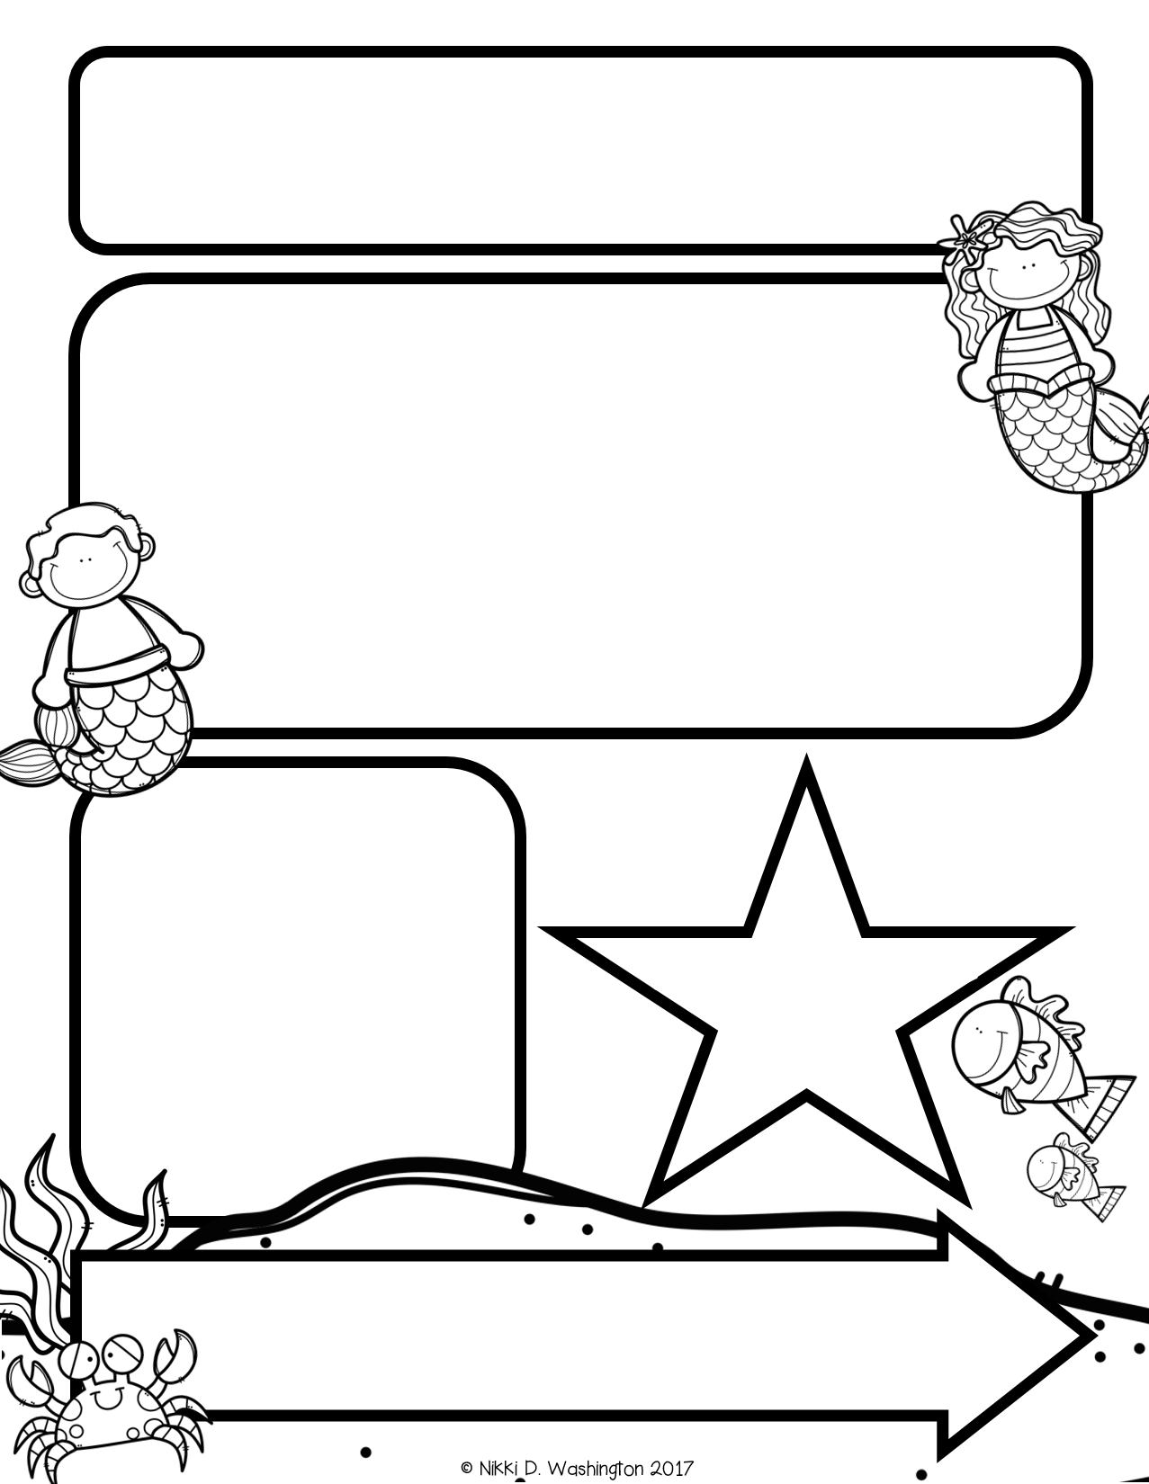
Mrs. Zeock’s Class
Newsletter
9/21/2018
The Kindergarteners had a fun Clifford day! We will be doing themed days like that throughout the year ☺. It is a nice break for the kids.
Attached is a letter describing a state assessment that we are required to give this year. If you have any questions, please let me know.
If you have not already paid for the field trip, please do so asap. Also, make sure you turned in your background checks if you are planning to go. You are now allowed to go if you are not on the list. We have a lot of parents planning to attend, so I will let you know as soon as I can if I need some parents to drive.
Up Coming Events
September 27-Watch Dog Night
September 28-Purple Game at OHS
October 4-Field Trip
October 8-Picture Day
October 25-Fall Fest
October 31-Halloween Party
Supplies needed:
Volunteers needed: In the upcoming months, I will need
volunteers to help listen to students read. I will send out more information at a later date.

Slide 2
Math
We continued unit 1 in math. The students are learning the numbers 1, 2, 3, 4, and 5. They have learned how to count objects and write the numbers.
*I started sending home a homework sheet from the lesson we covered during the day. Please complete this with your child for extra practice; however, you do not have to return it.
Reading and Writing
This week we learned the letters S, T, N, and R. We learned the name, sound, and how to write each letter. The students also worked on reading pictures and going back in the story to find things that they did not see the first time.
Science

