Slide 1
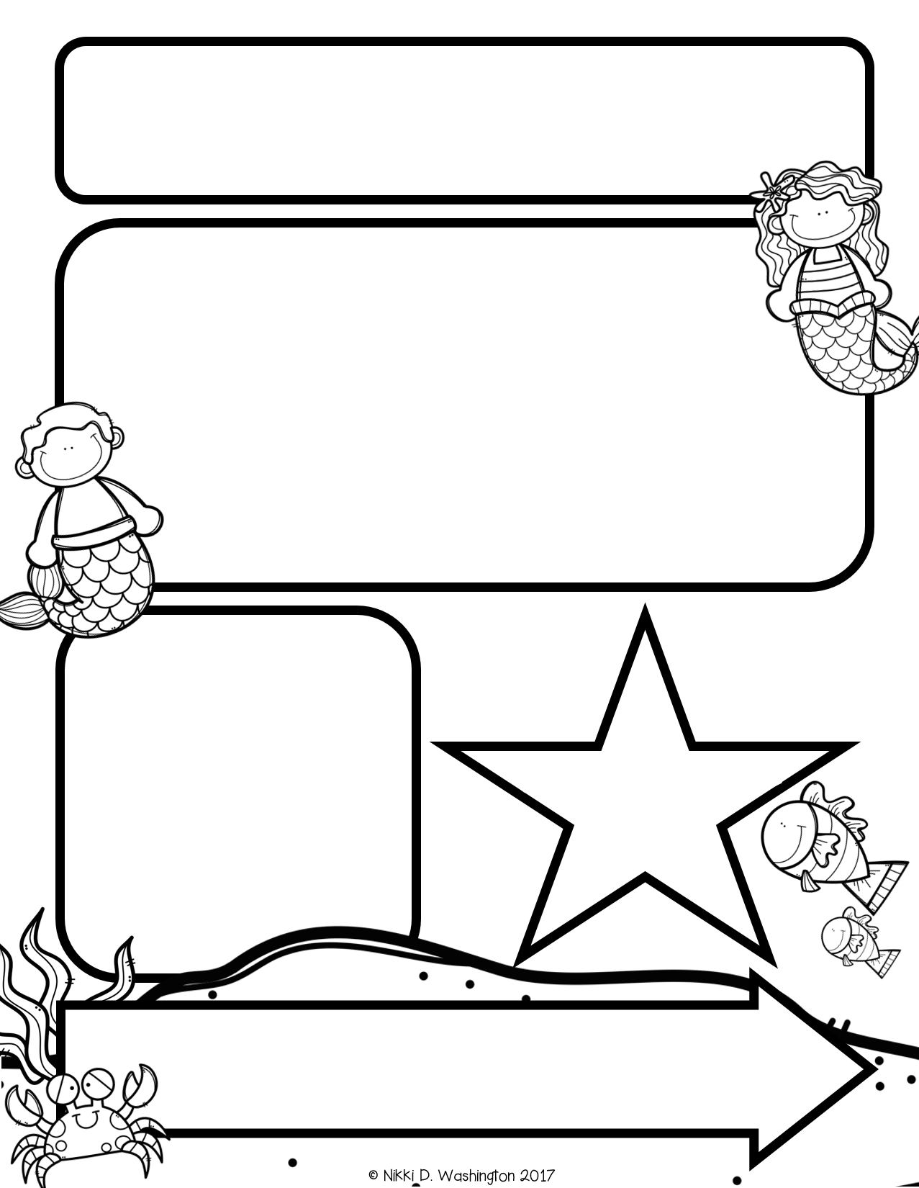
Mrs. Zeock’s Class
Newsletter
10/5/2018
Thank you for making the field trip such a positive experience for the kids. They had a great time!
Please do not forget to send in $5.00 for our school holiday parties.
Many of you have already paid, so thank you!
Monday is picture day for Kindergarten! They try to get our kids first, so hopefully their hair still looks good ☺.
Fall Fest is coming up. If you would like to volunteer during Fall Fest, please let me know and I will let Mrs. Griffith know, so she can contact you.
Up Coming Events
October 8-Picture Day
October 25-Fall Fest
October 31-Halloween Party
Supplies needed:
Volunteers needed: I will need about 5 parent volunteers on Halloween to help with stations at our classroom party in the afternoon.

Slide 2
Math
The kids took their first math test this week! They all did a great job. I do not send the tests home since grades are not given in Kindergarten. It is mainly for my benefit to see how each student is learning and to give them the experience of test taking. We began Unit 2 which continues working on numbers 1-5.
Reading and Writing
This week we learned the letters D and F. We learned the name, sound, and how to write each letter. The students also worked on “owning” the letters in their name by teaching other students how to write the first letter to their name. They also worked on rhyming words by putting different letters in front of their name.
The class is also starting to learn sight words. The first two sight words they have learned are “a” and “the.”
Science

