Slide 1
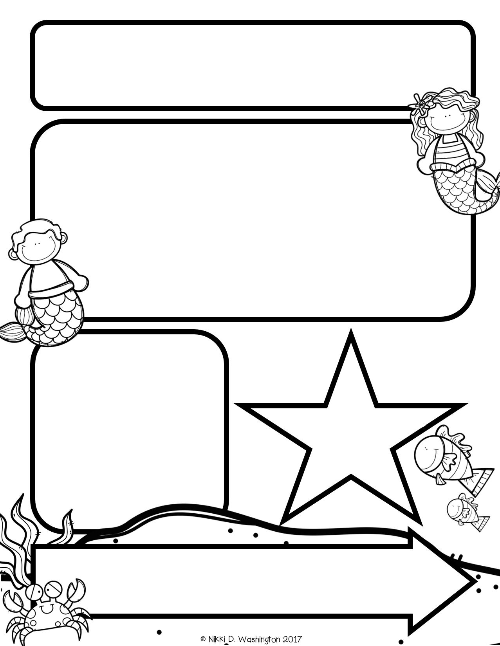
Mrs. Zeock’s Class
Newsletter
10/12/2018
I finally got my classroom website up and running with this year’s information! The website is www.zeock.weebly.com. On the website you will find an upcoming calendar, specials schedule, a need list, all of the newsletters, and pictures of your kids!
Believe it or not, some of your kids are starting to read! When I feel they are ready, your child will be coming home with a “backpack buddy” book in a ziplock bag with instructions. Please have your child read the book to you several times and return it to class. They will then read it again to someone here and if they do well, they will get another book to bring home. I am asking this year for a parent volunteer to come in and listen to students read. I will need someone from 8:30-9:00am. If you are able to commit to this time, please let me know. If you can only do one day a week, that is fine too. Thank you!
Up Coming Events
October 25-Fall Fest
October 31-Halloween Party
Supplies needed:
Volunteers needed: I will need about 5 parent volunteers on Halloween to help with stations at our classroom party in the afternoon.

Slide 2
Math
The students are working on Unit 2. Unit 2 introduces greater than and less than using the numbers 0-5.
Reading and Writing
This week we learned the letters I, V, and P. We talked about what it meant to have a favorite storybook and how we needed to have someone read it to us over and over again, so we could retell the story. We talked about when retelling a story, our words needed to match the pictures. Lastly, we talked about characters in a book and how our voices can change depending on what character is talking.
Because it is so important for your kids to continuously be read to, I am trying something new this year. We go to the library every Friday. Normally, the books stay here at school; however, this year, I am going to have the students pick two books. One book will stay at school, the other book will be sent home for the week. Please read your child’s library book to him/her every night and return it the next Friday. Thank you!
Science
Letters:
M S T N A R L D F I V P
Snap Words: a, the, me, it, is

